Slide 1
CS 113 Final Project
Created by Jack, Zach, Julian, Andrew, Nathan

Slide 2
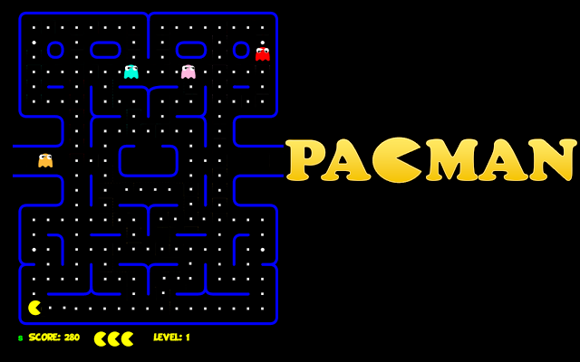
The goal

Slide 3
The goal
Create a game that embodies the essence of Pacman
Allow the player to choose a direction to move (continuously)
Have unique entities like coins, cherries, walls, and ghosts.
Handle hit detection and results between entities.
Coins: Can be picked up when the player touches them.
Cherries: Similar to coins, but with a twist…
Walls: Prevents the player and ghosts from moving through an area.
Ghosts: Ends the player upon contact.
Allow enemies to move (toward the player, randomly, in patterns…)

Slide 4
The approach
Create several classes which define, control, or display the game.
Position2D: Defines 2D spaces for hit detection size and coordinates
Entity: Base class of all entities such as Pacman, Walls, Ghosts, etc…
SystemManager: Hosts logic, movement input, and entity creation.
GraphicsController: Extends JFrame to display the game.
CenterPanel: Extends JPanel to draw entities.
MainDriver: Contains main method used at runtime.

Slide 5
The approach
The Position2D Class:
Defines where an entity is.
Defines how much space an entity occupies.
Fairly straightforward class.
Uses integers (int) to record a position in the game with X, Y coordinates.
Uses integers (int) to record a size in the game with width and height.
Contains methods to compare Positions for overlap (collisions).

Slide 6
The approach
The Entity Class:
Inspired by Minecraft’s Entity Class.
Has a Position2D object.
Has a Color object.
Minor control over movement.
paintEntity method: Uses a Graphics object to draw this entity.
Parent class of all entities in the game.
Pacman: Represents the player. Can be steered using the arrow keys.
Ghosts: Chase the player.
Coins: pickup.
Walls: Keeps the player, and ghosts in bounds.

Slide 7
The approach
The SystemManager Class:
Primary controller.
Initializes entities.
Records details like coin and cherry scores.
Has PlayerController, a nested class that implements KeyListener.
Responsible for some hit detection.

Slide 8
The approach
The GraphicsController Class:
Extends JFrame to use swing.
Creates an environment for the graphics to be displayed.
Uses a BorderLayout.
Uses witchcraft threading to redraw.
Has a SystemManager object.
Uses SystemManager’s PlayerListener.
Has a CenterPanel…

Slide 9
The approach
The CenterPanel Class:
Responsible for drawing the pixels we care about.
Extends JPanel with a constructor that accepts an ArrayList of Entity.
Is used by GraphicsController in the center of the BorderLayout.
Has the GraphicsController’s SystemManager’s Entity ArrayLIst passed.
Iterates over the ArrayList of Entity and calls each entity’s drawEntity.

Slide 10
The approach
Data Structures Used:
Arrays.
Buried in there, somewhere.
ArrayLists, lots of ArrayLists.
Primary means of containing Entities and Collisions.
Easy to use, hard on the rubric.
Enums (c’mon).
At least two enums are defined by the Entity class
Direction contains… directions.
Shape is used by the drawEntity method to draw rectangles or circles.
HashMap(s).
Pacman uses a HashMap to alternate between mouth states.
Has a Boolean as a key, with an Integer that is used for the arc angle as a value.

Slide 11
The approach
Algorithms:
Going off the grid.
Map is not array based.
Entities ‘could’ occupy the same space unlike an array.
Complete freedom.
Hit Detection.
Handling hit detection without checking an array’s neighbor takes work.
Check for overlap based on Position2D coordinates and size.
Produce appropriate results based on Entity types and overlaps.
Seeking Patterns…

Slide 12
The approach
Seeking Patterns For Real This Time:
Huge aspect of what makes the game tick.
Multiple patterns to make the ghosts unique.
Straight at you!
Stop mirroring me!
Teleporting! Game over man!
Having difficulty getting over that wall.
Ghosts camp like pros.
Largely written by the person not writing this slide.

Slide 13
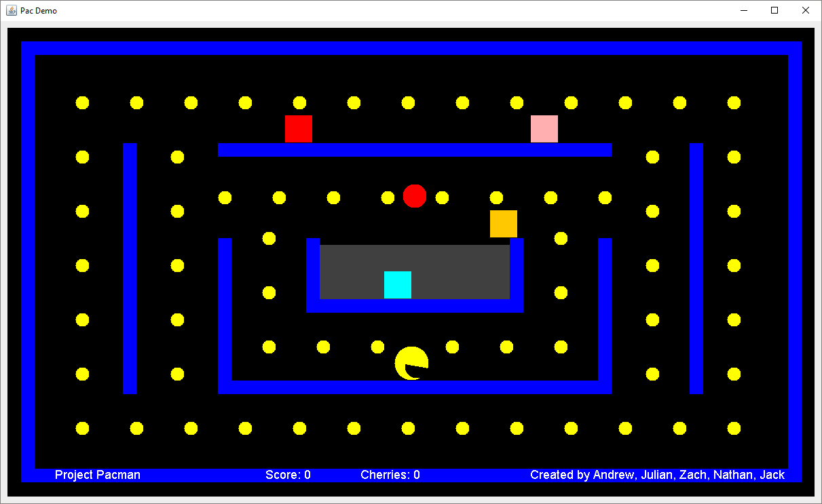
The result

Slide 14
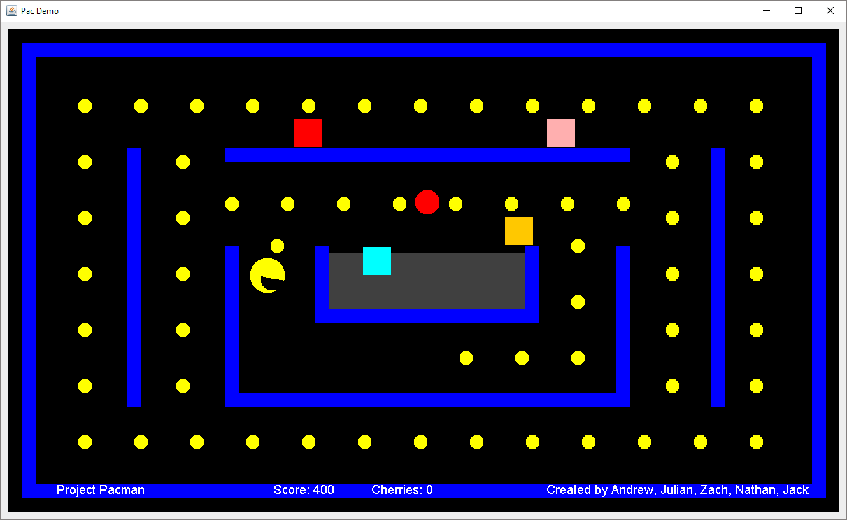
The result

Slide 15
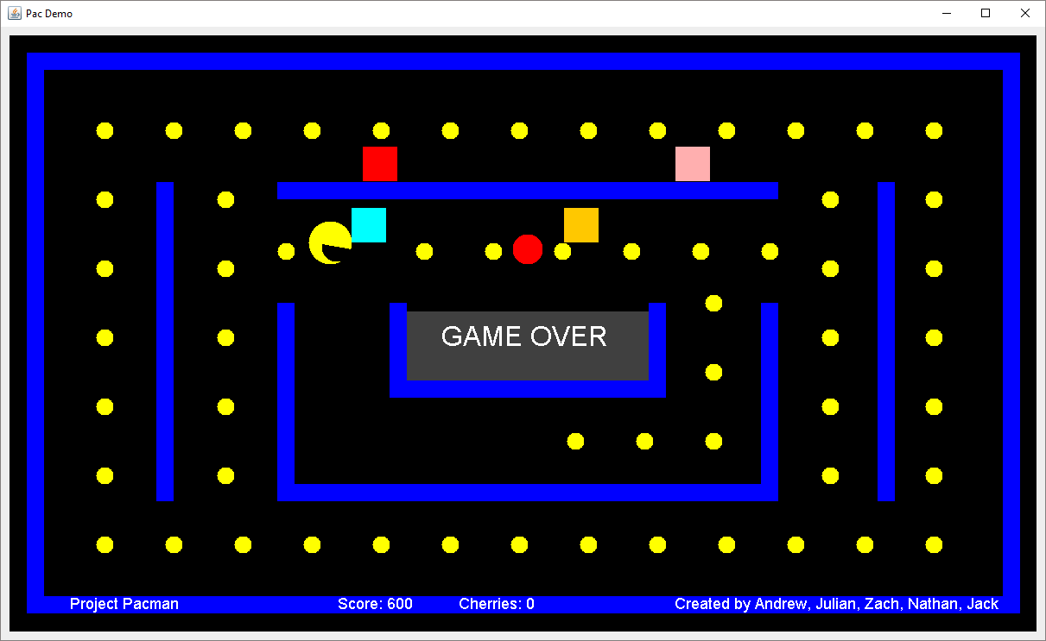
The result

